Slide 1
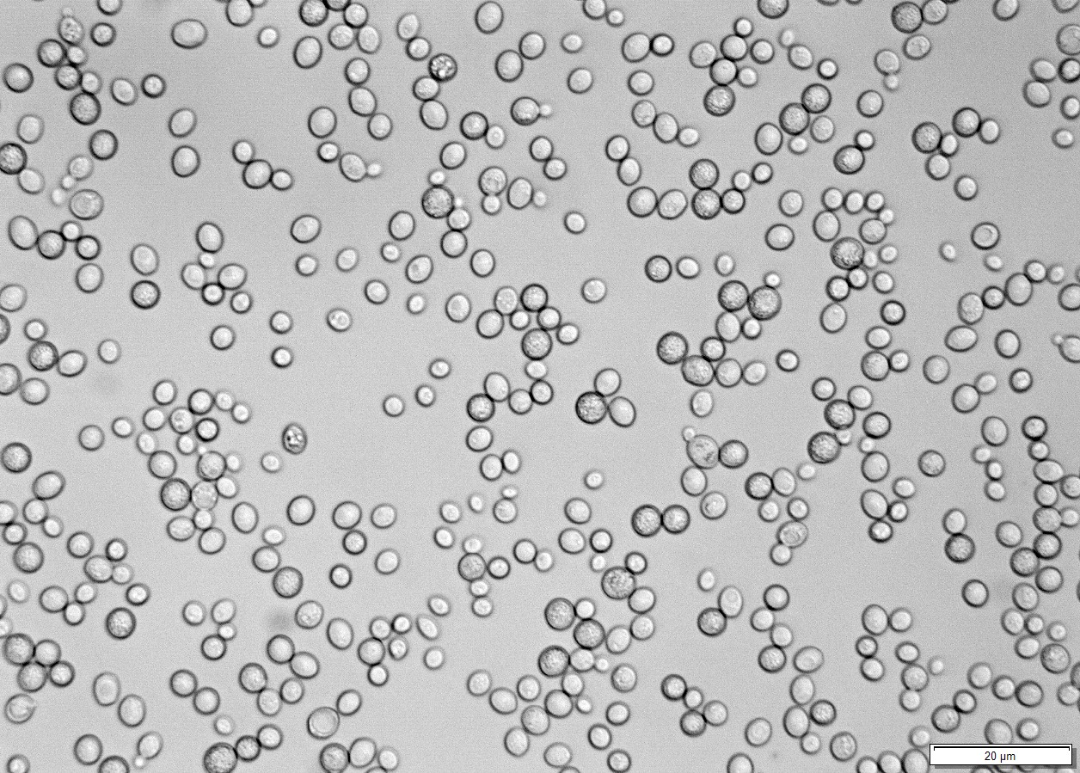
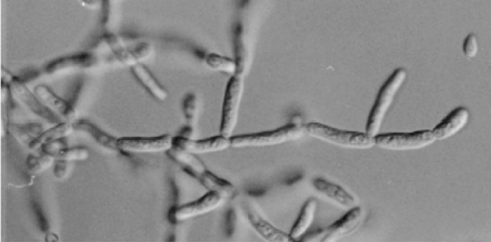
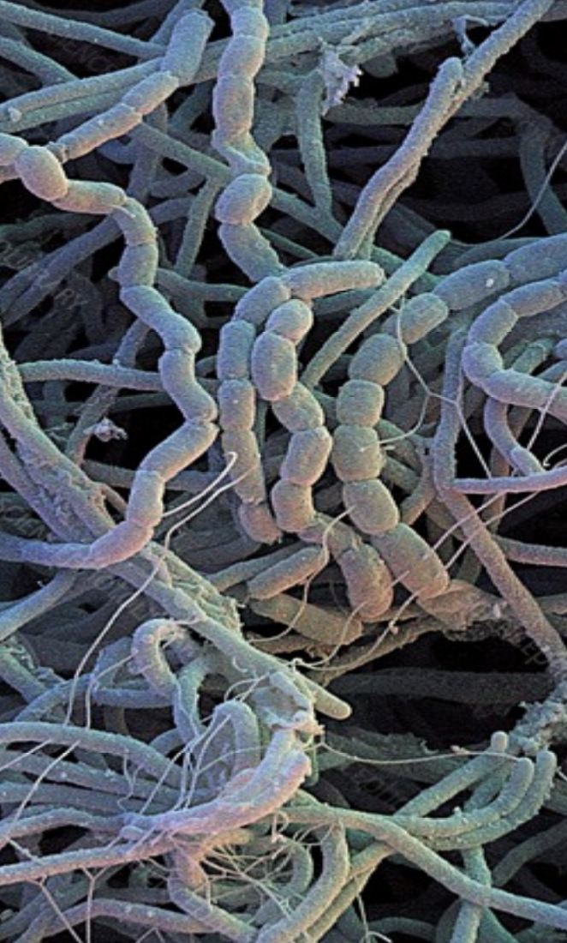
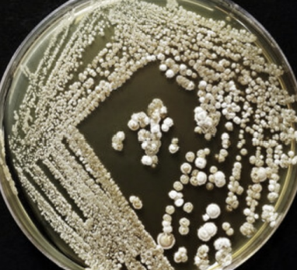
SBC.07107 Bioinformatics Group-F presentation
Isaac Ambrogetti/ Augustin Beaud/
Morgane Gull / Tom Lüthi

Slide 2
Yeast Mutant
Introduction | Saccharomyces cerevisiae – switches from unicellular to filamentous growth phenotype under specific environmental and genetic conditions
 | phenotype transition regulated by Mitogen-Activated Protein Kinase (MAPK) pathway – filamentous (fMAPK) pathway
 | WT strain carries a ste4 mutation (∑1278b/ste4∆) disrupting fMAPK pathway
 | 4 strains (B4c3, F24c1, J44c1, M56c2) selected (SD-HIS + 10 mM 3-ATA) – restore fMAPK pathway
Strain | Position of Mutation | Type of Mutation | Alteration | Affected Gene
B4c3 | VII: 1067506 | frameshift (HIGH) | TCC → AXC | IMA1
B4c4 | VII: 576228 | stop gained (HIGH) | TGG → TGA | KSS1
B4c5 | XII: 1003220 | missense (MODERATE) | GTT → CTT | IMD3
B4c6 | XV: 172670 | missense (MODERATE) | ACC → AAC | IRA2
F24c1 | VIII: 275671 | stop_gained (HIGH) | TCT → TTT | STE12
J44c1 | IV: 527747 | missense (MODERATE) | ACT → ATT | ENA5
J44c2 | XII: 851652 | missense (MODERATE) | ACT → ATT | STE11
M56c1 | VII: 481460 | missense (MODERATE) | GTC → GTG | PMA1
M56c2 | VI: 124983 | stop_gained (HIGH) | TCA → TAA | BLM10
FUS1-LacZ expression level
= Hyperactivity of fMAPK pathway
High
Medium
Low

Slide 3
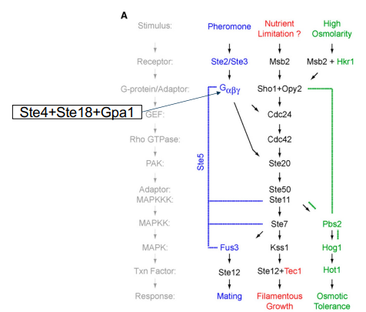
Suppressor mutation of fMAPK pathway
MAPK pathway :
Candidates:
STE11 | Function: activates STE7 Mutation: missense – T₅₉₆ → I₅₉₆ Consequence: close to/ in catalytic site
KSS1 | Function: activates STE12 Mutation: stop gained – W₈₃₁ → * Consequence: truncation of ~100 AA at the C-terminal, loss of regulatory domain
STE12 | Function: expression of filamentation genes Mutation: stop gained – Q₅₀₀ → * Consequence: loss of last 188 AA, part of DIG1/DIG2 interaction domain

Slide 4
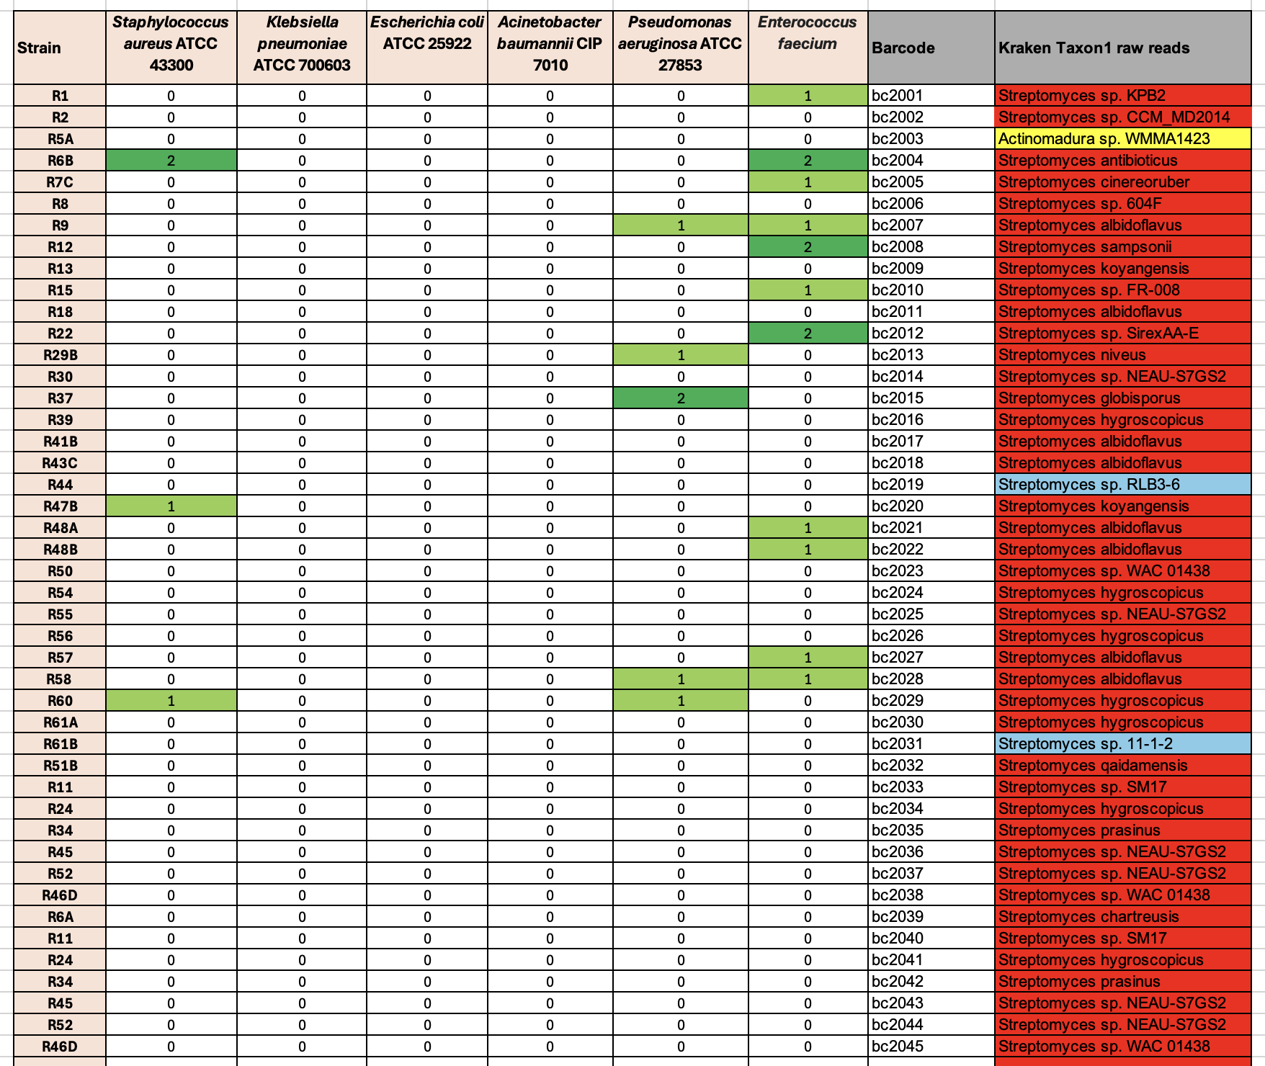
De novo assembly
Introduction | Discovering new antibiotics produced by Actinomycetes to overcome antimicrobial resistances
 | Samples obtained from Swiss soils : Botanical garden (UNIFR), Moos Düdinngen, Bern-Aare forest, Schwarzsee, Geneva – ~80 isolates purified from SCA media
 | Activity screening + Genome mining + Metabolomic analysis – Identify and synthesize bioactive Metabolites/ Antibiotics
 | Genome mining: De novo genome assembly → genome anntation (findign genes) → detect biosynthesis gene clusters
Our strains :

Slide 5
Biosynthesis gene clusters
Rresults Augustin

Slide 6
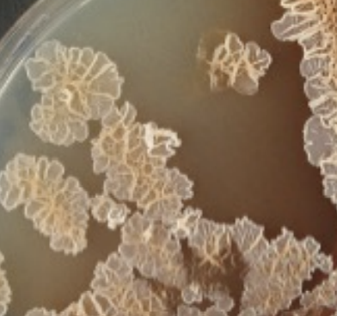
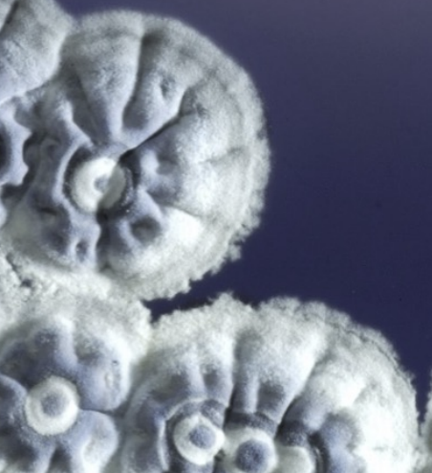
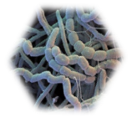
Thank you for Listening
Do you have any questions?

